Slide 1

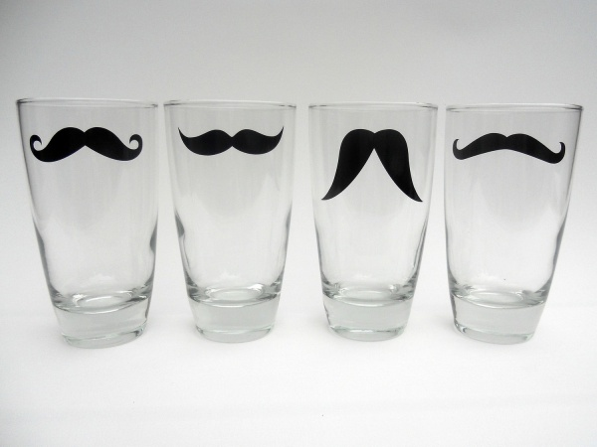
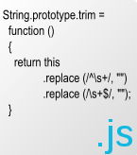
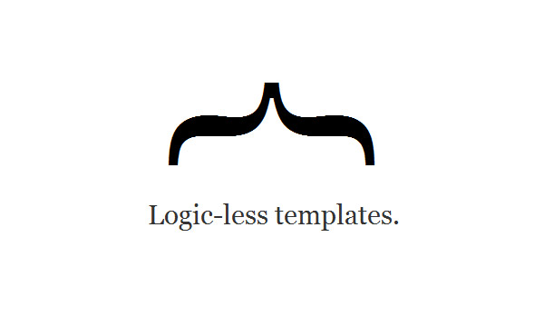
mustache.js
Making JavaScript code by template!
Nikolay Kostov
Team Lead, Senior Developer and Trainer
http://Nikolay.IT
Telerik Software Academy
academy.telerik.com

Slide 2
Table of Contents
mustache.js Overview
Using mustache.js
Simple Templates
Property Templates
Sections and Inverted Sections
Function Templates
HTML Templates

Slide 3
mustache.js

Slide 4
mustache.js
An implementation of the mustache template system
Can be used for Web and nodeJS
Provides a way to format JavaScript strings using a predefined template
Much like String.Format() in C# and Java
Mainly used to parse data into HTML, using item templates

Slide 5
Using mustache.js
To use mustache.js, include it in a web page
There are a few ways to format a string
Yet the basic one is using a {{data}} statement
//the object to pass to the template
var view = {
fname: "Nikolay",
lname: "Kostov"
}
//mustache searches the given object for properties //named "fname" and "lname"
//if found, the statements in {{}} are replaced with the //corresponding values
var template = "I am {{fname}} {{lname}}";
var output = Mustache.render(template, view);
//returns as a result "I am Nikolay Kostov"

Slide 6
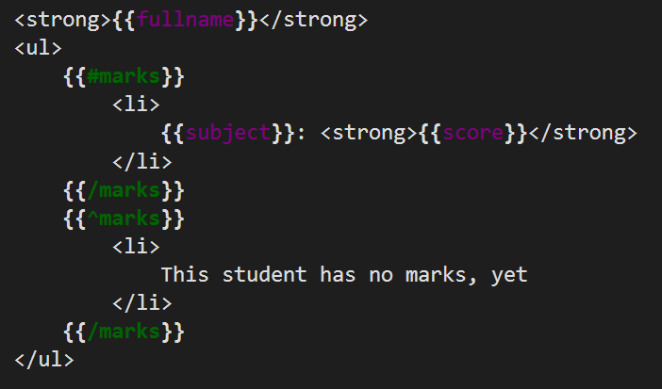
Simple Templates
Live Demo

Slide 7
Templates
Yet, mustache.js can bind not only to properties, but to the properties of properties
var phone = {
vendor: "Samsung",
model: "Galaxy S4",
os: {
name: "Android",
version: "Jelly Bean"
}
}
var template = "My phone is {{vendor}} {{model}} and it " +
"is running {{os.name}} {{os.version}}";
var output = Mustache.render(template, phone);

Slide 8
Property Templating
Live Demo

Slide 9
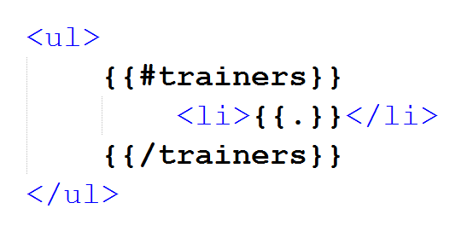
Sections in mustache.js

Slide 10
Sections
Section is a place where list data is evaluated
Feels like if-else statements
Section evaluate the value of a property, and if it is evaluated to "true", show it
Sections start with {{#prop_name}} and end with {{/prop_name}}
var student = {
name: "Pesho Georgiev",
marks: […]
}
var template = "{{name}} has " +
"{{#marks}} {{marks.length}}" + "{{/marks}} marks";

Slide 11
Simple Sections
Live Demo

Slide 12
List Sections
The idea behind sections is to render list data
i.e. the template inside the section is repeated for every item of the collection
Something like a for loop
var view = {
trainers: ["Doncho", "Niki", "Joro", "Ivaylo", Nakov"]
};
var template = "<ul>" +
"{{#trainers}}" +
"<li>{{.}}</li>" +
"{{/trainers}}" +
"</ul>";
Mustache.render(template, view);
//result: <ul><li>Doncho</li><li>Niki</li>…

Slide 13
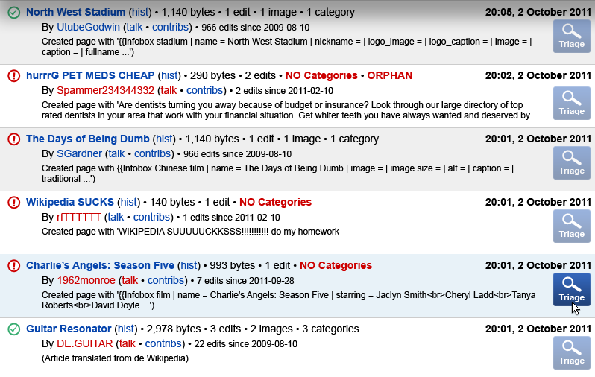
List Sections
Live Demo

Slide 14
Inverted Sections
As said earlier, sections work like a if-else statement
The regular sections are the IF statements
The inverted sections are the ELSE statements
Inverted sections start with {{^prop}} and end with {{/prop}}
Inverted sections are rendered only if the property is evaluated to "false"

Slide 15
Inverted Sections: Example
Only one of the students has no marks
var view = {
students: [
{ name: "Pesho", marks: [5, 4, 3.5] },
{ name: "Gosho" },
{ name: "Mimeto", marks: [6.5, 5.3, 3.5] }
]
};
var template =
"{{#students}} {{name}} has " +
"{{#marks}} {{.}} {{/marks}}" +
"{{^marks}} no marks {{/marks}}\n" +
"{{/students}}";

Slide 16
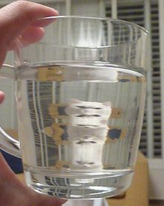
Inverted Sections
Live Demo

Slide 17
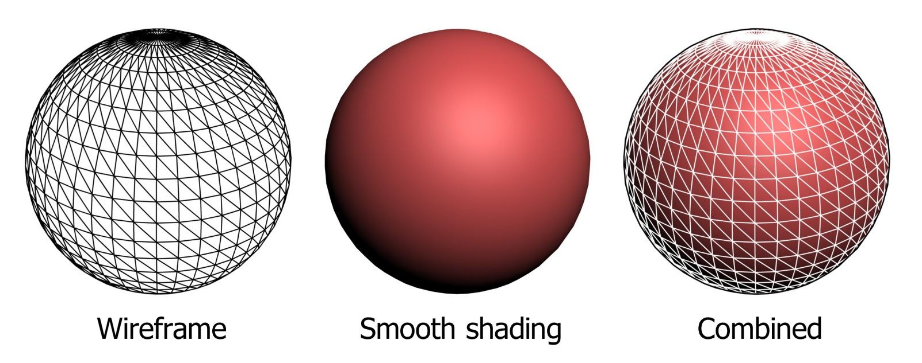
Render Functions

Slide 18
Render Functions
Mustache.js can use render functions, if they are defined in the object
Define a render function to control the rendering of your object
var person = {
fname: "Nikolay", lname: "Kostov",
fullname: function () {
return this.fname + " " + this.lname; },
render: function () {
return function (text, render) {
return "<strong>" + render(text) + "</strong>";
}
}
};
var template = "{{#render}} {{fullname}} {{/render}}";
var output = Mustache.render(template, person);

Slide 19
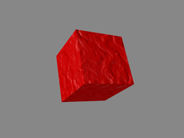
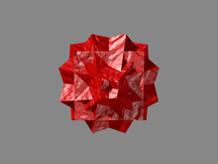
Render Functions
Live Demo

Slide 20

HTML Templates

Slide 21
HTML Templates
Mustache.js can render objects into HTML code
As in KendoUI, jQueryTemplates, AngularJS, etc.
Create a script tag with an invalid type value
Put the template inside
<script type="text/x-must-tmpl" id="person-template">
<strong>{{fullname}}</strong>
<ul>
{{#marks}}
<li>{{subject}}: <strong>{{score}}</strong></li>
{{/marks}}
{{^marks}}
<li>This student has no marks, yet</li>
{{/marks}}
</ul>
</script>

Slide 22
HTML Templates (2)
Implement a render function that takes a template
function render(items, template) {
var list = document.createElement("ul");
for (var i = 0; i < items.length; i++) {
var listItem = document.createElement("li");
var item = this.itemsSource[i];
listItem.innerHTML = template(item);
list.appendChild(listItem);
}
return list.outerHTML;
}

Slide 23
HTML Templates (3)
Using compiled templates, pass an item collection and the compiled template
var templateHTML =
document.getElementById("person-template").innerHTML;
var template = Mustache.compile(templateHTML);
var people = […]
render(people, template);

Slide 24
HTML Templates
Live Demo

Slide 25
mustache.js
http://academy.telerik.com

Slide 26
Homework
Change the ListView from the last demo to use TABLE instead of UL
The TableView gets number of rows and columns in its constructor
The TableView renders the elements in table cells
Each element gets only a single cell

Slide 27
Homework (2)
Create a Master-detail for an array of students students and their marks
Each student has:
Name, grade
Set of marks
Create a template for rendering students
Create a template for rendering marks
When student is clicked, their marks must be rendered in another HTML element

Slide 28




Free Trainings @ Telerik Academy
“C# Programming @ Telerik Academy
csharpfundamentals.telerik.com
Telerik Software Academy
academy.telerik.com
Telerik Academy @ Facebook
facebook.com/TelerikAcademy
Telerik Software Academy Forums
forums.academy.telerik.com

